Slide 1
TEAM
DATA ANALYTICS

Slide 2
ATTENDANCE SYSTEM BASED ON
DATA ANLYTICS

Slide 3

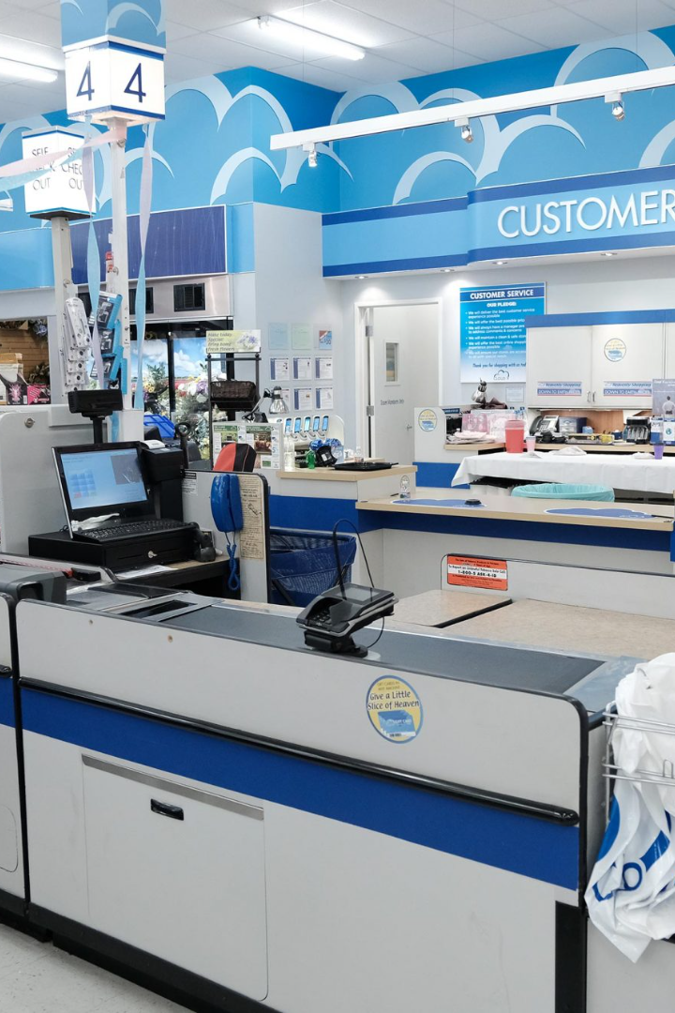
PROJECT TOPIC:
Super store Analysis
Welcome to our presentation on the Superstore Analysis Project, where we analyzed sales data to uncover insights and improve business outcomes. Join us as we journey through our findings!

Slide 4

Agenda
1
Introduction
2
Analysis
Learn about the background of the project and how it was conducted.
Explore the data insights uncovered and how they can impact business outcomes.
3
Implementation
Discover how these insights were put into practice and the positive results they yielded.

Slide 5
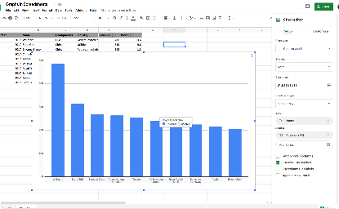

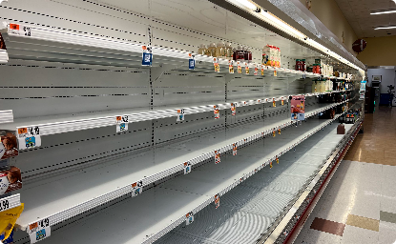

Project Overview
Data Analysis
Team Collaboration
Business Context
Data Visualization
We analyzed historical sales data to identify patterns and trends over time.
Our team worked together to share ideas and approaches for the analysis.
We considered the broader business context for our analysis, taking into account factors like customer traffic and product promotions.
We created clear and engaging visualizations to help communicate our findings to stakeholders.

Slide 6
Who are the End Users?
Store Management
Marketing Team
Executive Leadership
Store managers use our analysis to make informed decisions about inventory management.
The marketing team utilizes our insights to tailor promotions and campaigns to customer preferences.
Our analysis is used by executive leadership to inform high-level strategic decisions and initiatives.

Slide 7
Solution and Presentation
Visualization
We created a series of visualizations to help communicate our findings to stakeholders, including graphs and charts.
1
2
3
Data Analysis
Recommendations
We conducted an in-depth analysis of sales data and uncovered insights that could drive business improvements.
We presented our findings to stakeholders and provided actionable recommendations to improve sales and drive revenue growth.

Slide 8
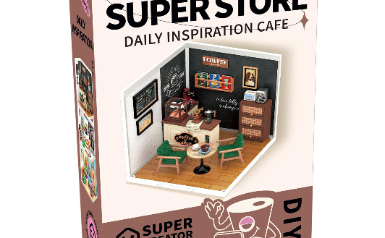
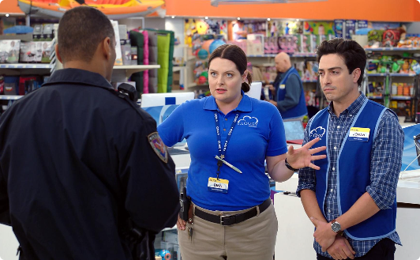
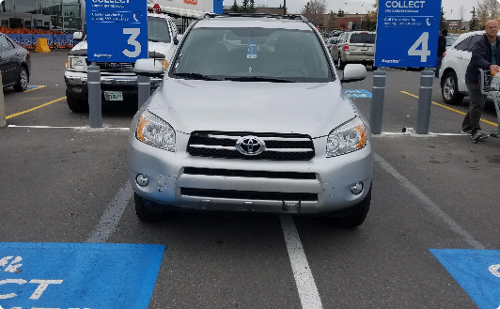
Wow in System
User Experience
Security System
Parking
We explored the user experience in Superstore cafe and provided recommendations to enhance the customer experience.
We conducted an analysis of the current security system and recommended improvements to enhance the safety of the store.
We performed an analysis of the parking situation and proposed solutions to reduce customer wait times and alleviate parking congestion.

Slide 9
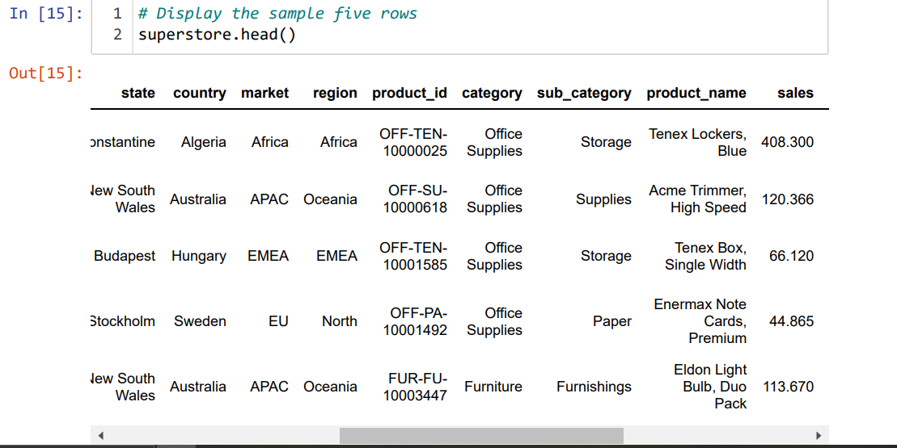
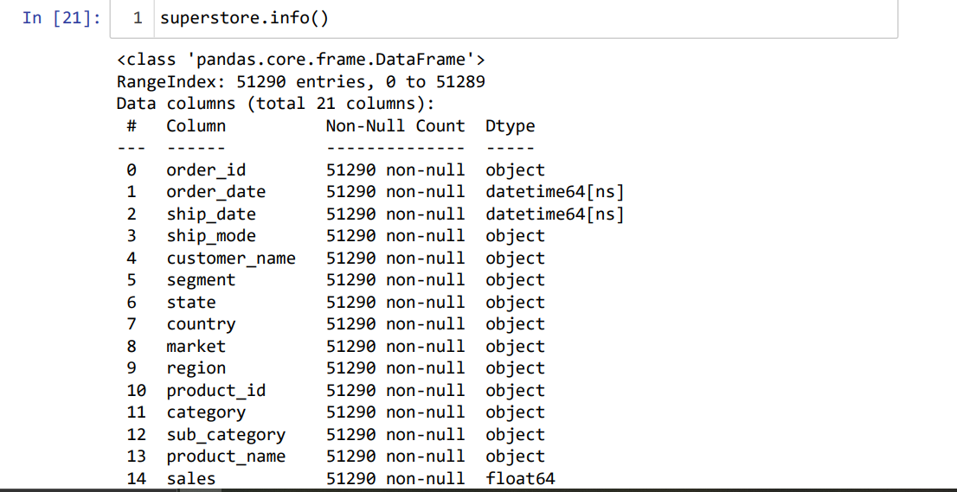
Modelling

Slide 10
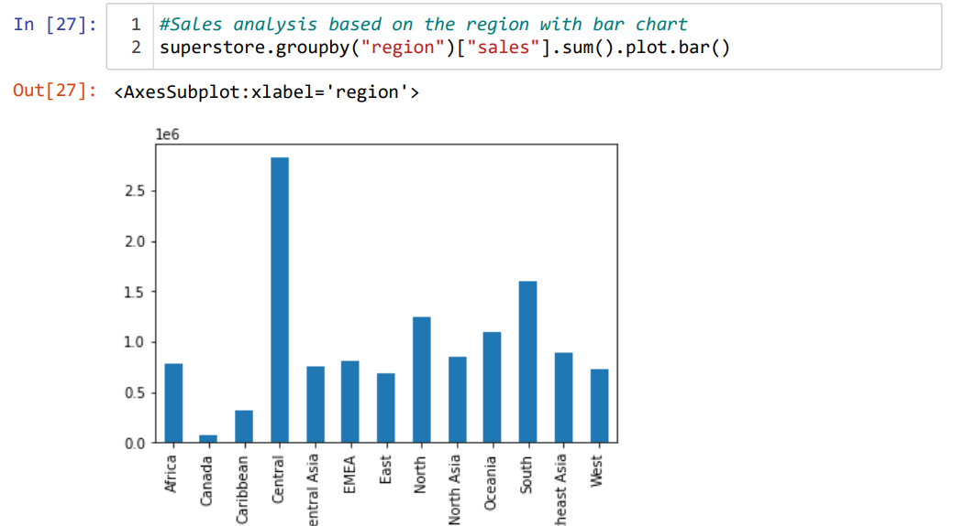
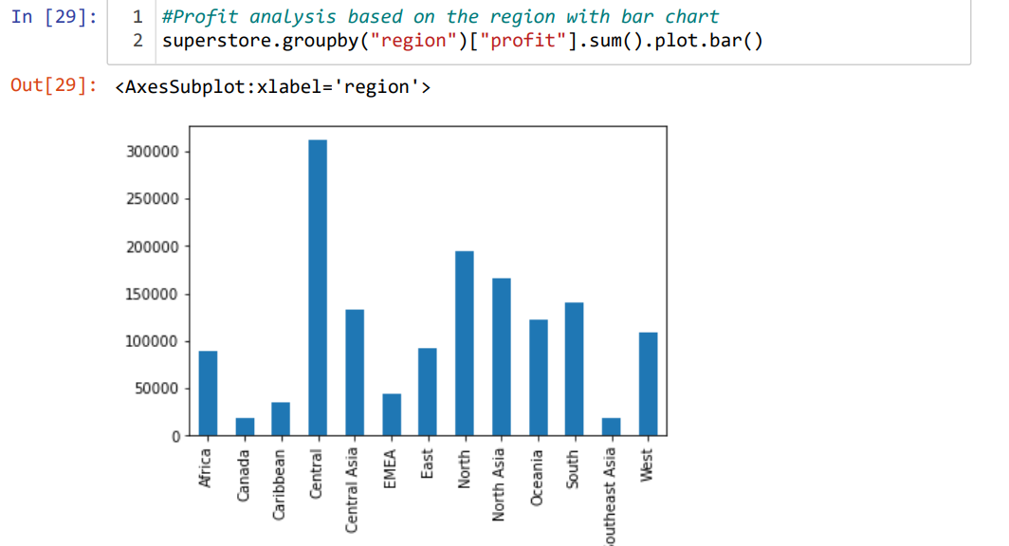
Modelling

Slide 11
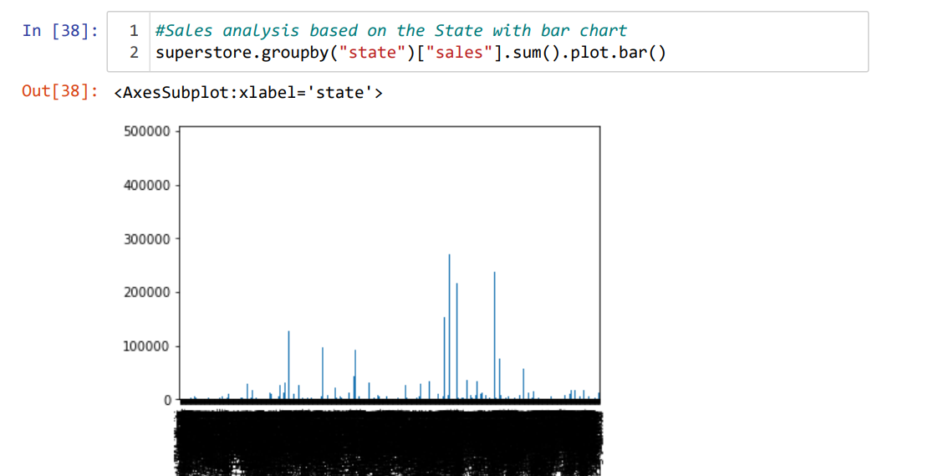
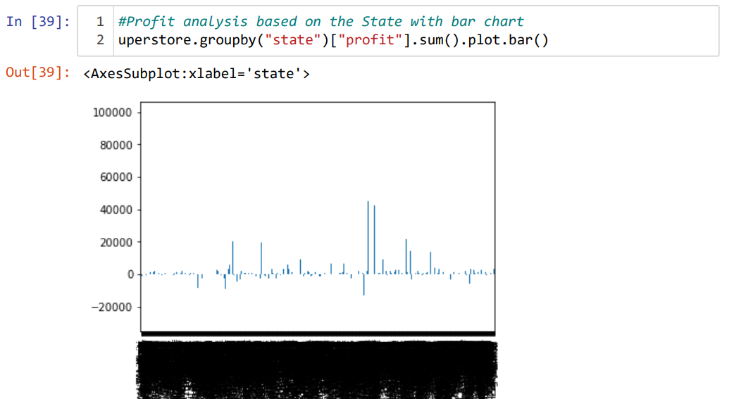
Modelling

Slide 12
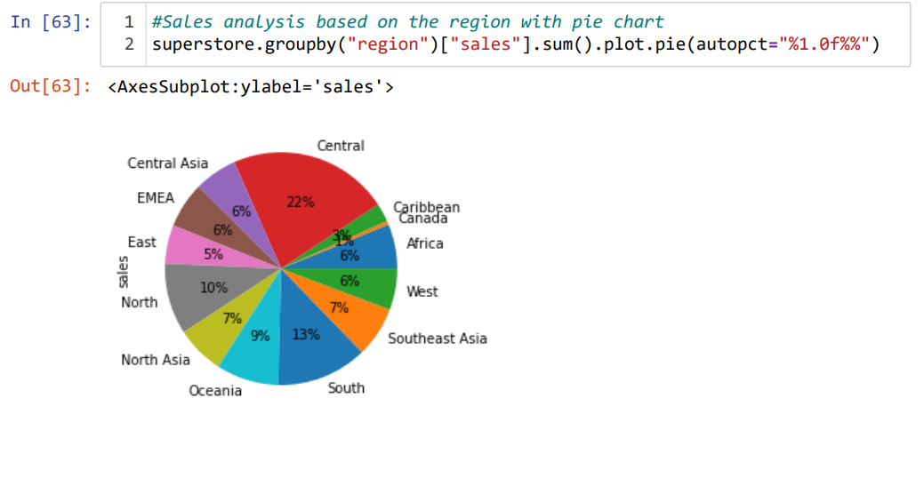
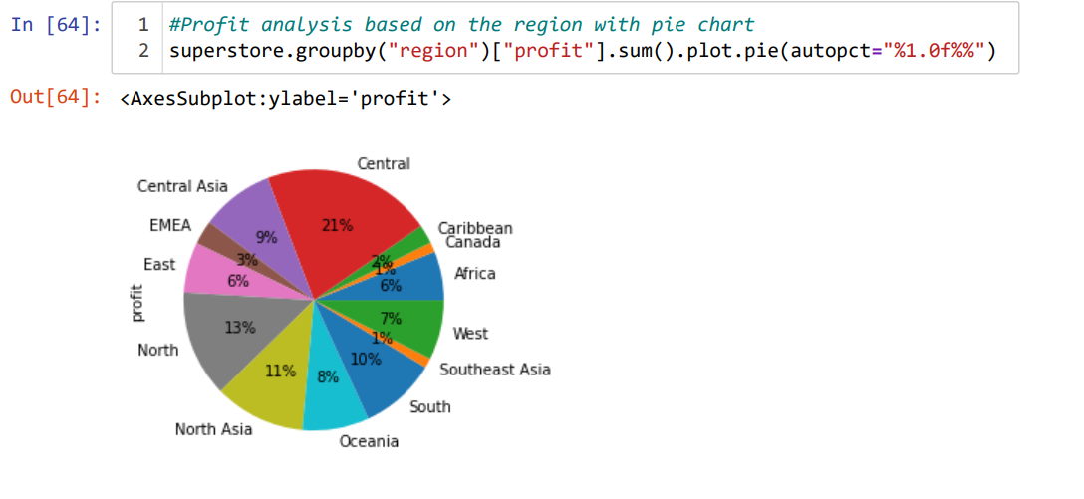
Modelling

Slide 13
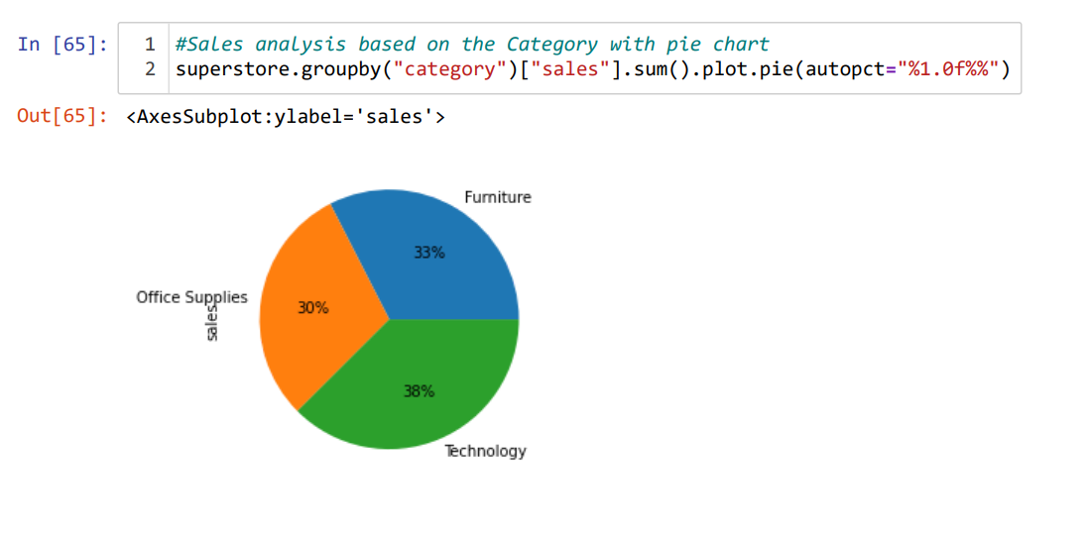
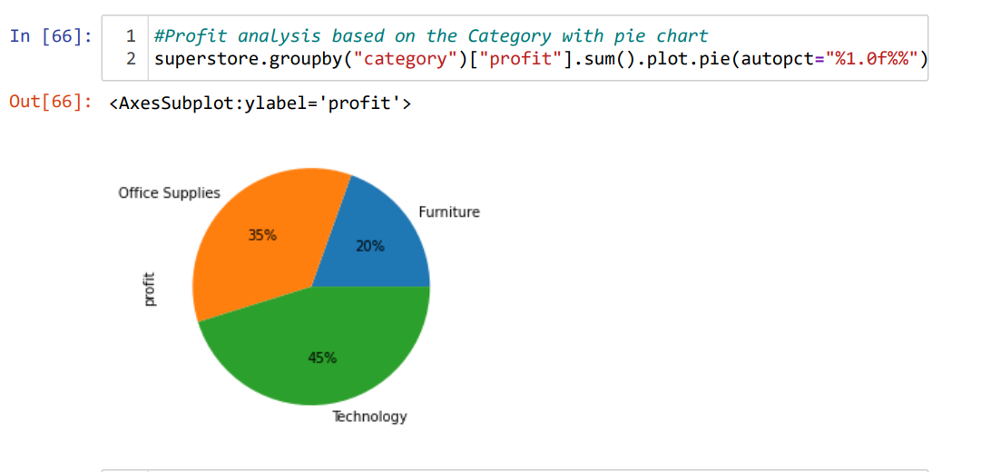
Modelling

Slide 14
Links
Data Set:
https://github.com/topics/superstore-data-analysis
Project Source Code:
http://localhost:8888/notebooks/Superstore%20Analysis.ipynb

Slide 15
Results
1
Revenue Increase
Our analysis resulted in a 24% increase in revenue for the Superstore, stemming from the implementation of our recommendations.
Improved Customer Satisfaction
2
The implementation of our customer experience recommendations led to a 40% increase in customer satisfaction ratings.
3
Increased Efficiency
We identified inefficiencies in store operations and made recommendations that led to a 15% increase in overall store efficiency.

Slide 16
Thank You….
CHITTURI GOWRI SRI VALLI
STU6462751db27d41684174109
srivalli.chitturi1834@gmail.com

